Slide 1

Stephanie’s Creations: Sprint 3 Review
Team 5:
Hannah Clark | Heather Siler | Lauren Geis
Notes:
Presenter: Lauren
Transition to next Presenter: NA this slide
Speaking Points
Good evening everyone! Our goal today is to provide a detailed story and demonstrate the value we've delivered in this sprint. We'll focus on how these deliverables contribute to the overall project objectives.
The value delivered in this Sprint will be realized in future construction of our IS for Stephanie. Once created and implemented our it will save her an estimated 200 hours annually in Inventory Management, Sales and Order Processing, Financial Reporting and Customer Communication.
This time can be reinvested into product creation, marketing, and business growth. We expect Stephanie to increase sales by 20% within the first year of implementing the IS we are creating for her this semester

Slide 2

Sprint 3 Introduction
DFD Package
Entity-Relationship Diagram
Program Plan
Sprint Highlights
Notes:
Presenter: Lauren
Transition to next Presenter: NA this slide
This Sprint our team spent extra time reflecting on the feedback received previously. As a result, we have decided to focus on demonstrating clear communication and iterative progress toward completion of this project for you tonight.
In terms of deliverables, Sprint 3 was focused on solidifying our understanding of the system's data flow and structure. We've made significant progress in documenting and visualizing these critical aspects. This sprint was important for laying a solid foundation for the development sprints that follow.

Slide 3
DFD PACKAGE
Context Diagram
Data Flow Diagram – Level 0
Data Flow Diagrams – Level 1
Notes:
Presenter: Lauren
Transition to next Presenter: NA this slide
Let's start with the Data Flow Diagram (DFD) package. This is a crucial deliverable as it visually represents how data moves through the system. We've completed revisions to the Context Diagram and construction the DFD Level 0 and Level 1 for all five of the core processes for the system.
We believe the combined 10 hours of time invested in our DFD Package this Sprint will prevent at least 20 hours of rework time in future sprints.
For our client, Stephanie, we believe a well designed IS will save her valuable time that can be invested in other areas to grow her business like creating new product and marketing.

Slide 4
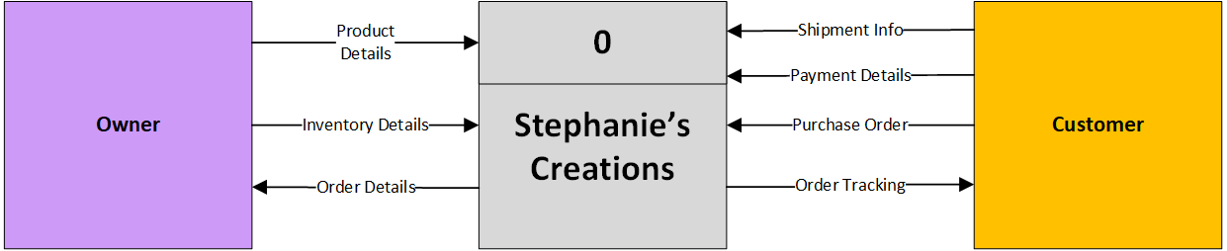
Notes:
Presenter: Lauren
Transition to next Presenter: NA this slide
For Sprint 3, we simplified our Context Diagram in order to make it more approachable for Stephanie.
By investing time in thorough analysis of data flow by providing a clear and concise visual representation, we have reduced the risk of costly errors and ensure that the system meets the needs of Stephanie’s business.
This level of documentation also facilitates better communication between developers and business stakeholders. By ensuring Stephanie has a thorough understanding of how data will flow through the IS at this stage, we will decrease the amount of time it takes her to be trained. There's a strong correlation between client involvement in DFD creation and a quantifiable decrease in the time it takes for them to become comfortable with a new Information System (IS). Our original estimate of the time frame for Stephanie to become proficient was 2 months. By leveraging the DFD package, our new estimate cuts that in half to only 1 month.

Slide 5
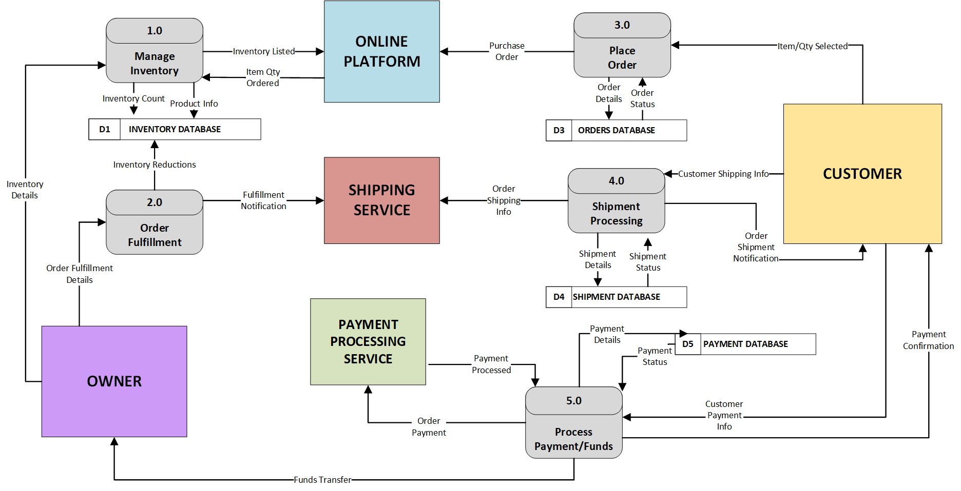
Notes:
Presenter: Lauren
Transition to next Presenter: NA this slide
This detailed DFD package allows us to identify potential bottlenecks and ensure data integrity. By visualizing the data flow, we've gained a deeper understanding of the system's processes, leading to more efficient design decisions.
I will now demo the DFD Level 0 and two of the Level 1 diagrams we created this sprint.
This slide contains the Level 0

Slide 6
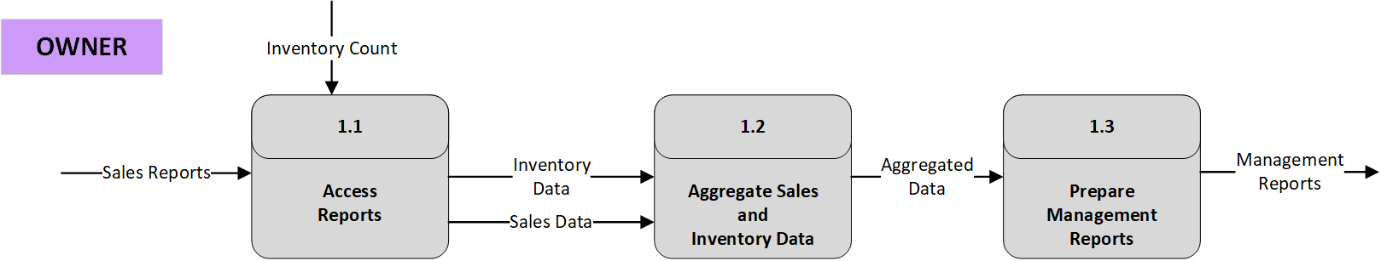
Notes:
Presenter: Lauren
Transition to next Presenter: NA this slide
This slide contains the Level 1 for the Manage Inventory Process 1

Slide 7
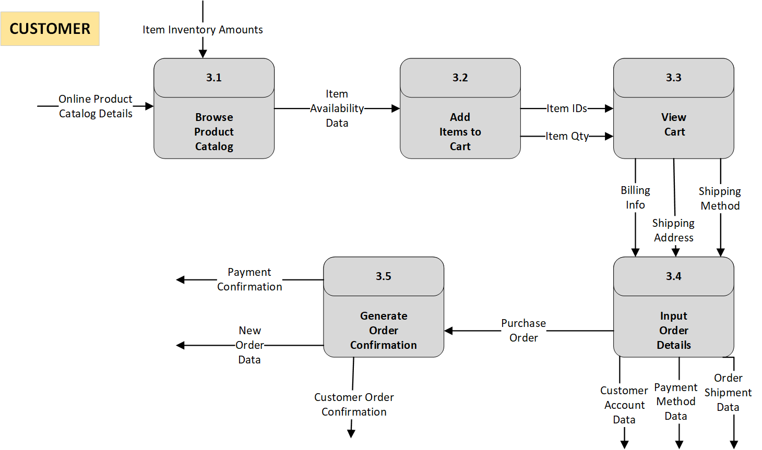
Notes:
Presenter: Lauren
Transition to next Presenter: NA this slide
This slide contains the Level 1 for the Place Order Process 3

Slide 8
Entity-relationship diagram
Notes:
Presenter: Lauren
Transition to next Presenter: NA this slide
Next, we'll look at the Entity Relationship Diagram (ERD). The ERD provides a clear picture of the data entities and their relationships.
The ERD is a key foundation for our database design. It ensures data consistency and reduces redundancy.

Slide 9
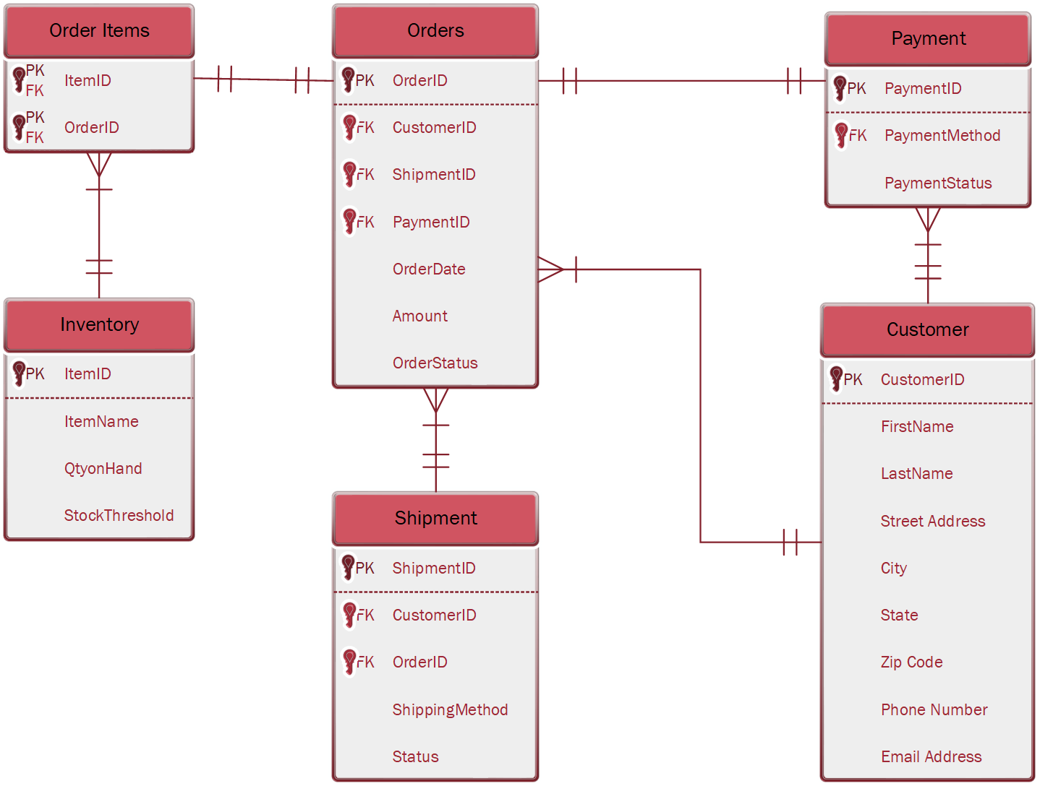
Notes:
Presenter: Lauren
Transition to next Presenter: Hannah
We have completed an initial ERD, and will continue to refine it as development progresses.
As a result of our discussions around and attention to Data Flows and Entity Relationships for the system, we have changed our Database provider to Firebase. By taking advantage of their free tier, this decision will save Stephanie’s business $240 in subscription fees. This backend-as-as-service platform will save our team an estimated range of 5-10 hours of time to create/manage the database. We plan to invest the time savings into strengthening the core functionality of our system. Stephanie’s business will benefit from increased scalability with this provider.

Slide 10
Program plan
Requirements
Programs & IPO Chart
Navigation Diagram
Notes:
Presenter: Hannah
Transition to next Presenter: NA this slide
Next, we'll look at the Input-Process-Output (IPO) charts. The IPO charts detail the logic and I/Os for each program.
The IPO charts break down complex processes into manageable steps, making development more straightforward.
Combined, the ERD and IPO charts provide a clear and organized method to transition from analysis to development. This will reduce development errors and improve code quality. We expect the work done on these deliverables this Sprint will save hours down the road for our team and our client. We expect to see development time savings through reduced rework that will lead to a reduction of 20% in development time, faster debugging that will save hours or days in debugging time, and improved code quality that translates to fewer bugs, better performance, and easier maintenance.
We expect to see implementation time savings through a smoother implementation process and faster user proficiency. Users who grasp the system's logic are less likely to encounter problems or ask for assistance. We anticipate this will save approximately 3-4 hours of support by our team during the first two months after implementation

Slide 11


requirements
Hardware
software
Desktop, laptop, or tablet capable of accessing internet
WiFi Router
Universal OS Compatibility
Windows, macOS, Linux, Android
Web Browser
Google Chrome, Firefox and Safari
Notes:
Presenter: Hannah
Transition to next Presenter: NA this slide
This slide covers the hardware and software requirements for our system so that the development can begin and we can build the correct environment.
By specifying the exact hardware and software needed upfront, we eliminate the risk of environment mismatches that lead to development delays. This can reduce development time by an estimated 15%.

Slide 12
Programs
Orders
Stores and manages data on customer orders, product details and transaction dates
Shipment
Records and organizes details on order shipping
Inventory
Tracks stock levels and gathers data to optimize inventory management
Notes:
Presenter: Hannah
Transition to next Presenter: NA this slide
This slide covers the programs included in our IS.
Our detailed IPO charts and program logic specifications reduce the risk of misinterpretations and coding errors, potentially saving developers hours of debugging and rework.

Slide 13
Program Inputs, Outputs & logic
Program | Inputs | Outputs | Processing Steps
Home Page | Orders Table, Shipment Tracking, Inventory Overview data | Displays order statuses, shipment tracking info, inventory summary | 1. Fetch data 2. Aggregate and format data 3. Display results
Orders Table | Customer Name, Item, Payment | Order stored in database Status updated | 1. Validate inputs 2. Generate Order ID 3. Store order 4. Update status
Shipment Tracking | New Orders, Older Orders | In-transit orders, Delayed shipments, Expected delivery dates | 1. Retrieve shipping details 2. Update shipment status
Inventory Overview | Product stock levels, Supplier data | Low stock alerts, Restock notifications, Updated stock levels | 1. Check stock levels 2. Generate restock alerts 3. Update inventory database
Notes:
Presenter: Hannah
Transition to next Presenter: NA this slide
This slide covers the Program Inputs, Outputs & Logic By mapping out all program inputs and outputs, we minimize the chance of data flow issues during development, estimated to save at least 10 development hours.

Slide 14
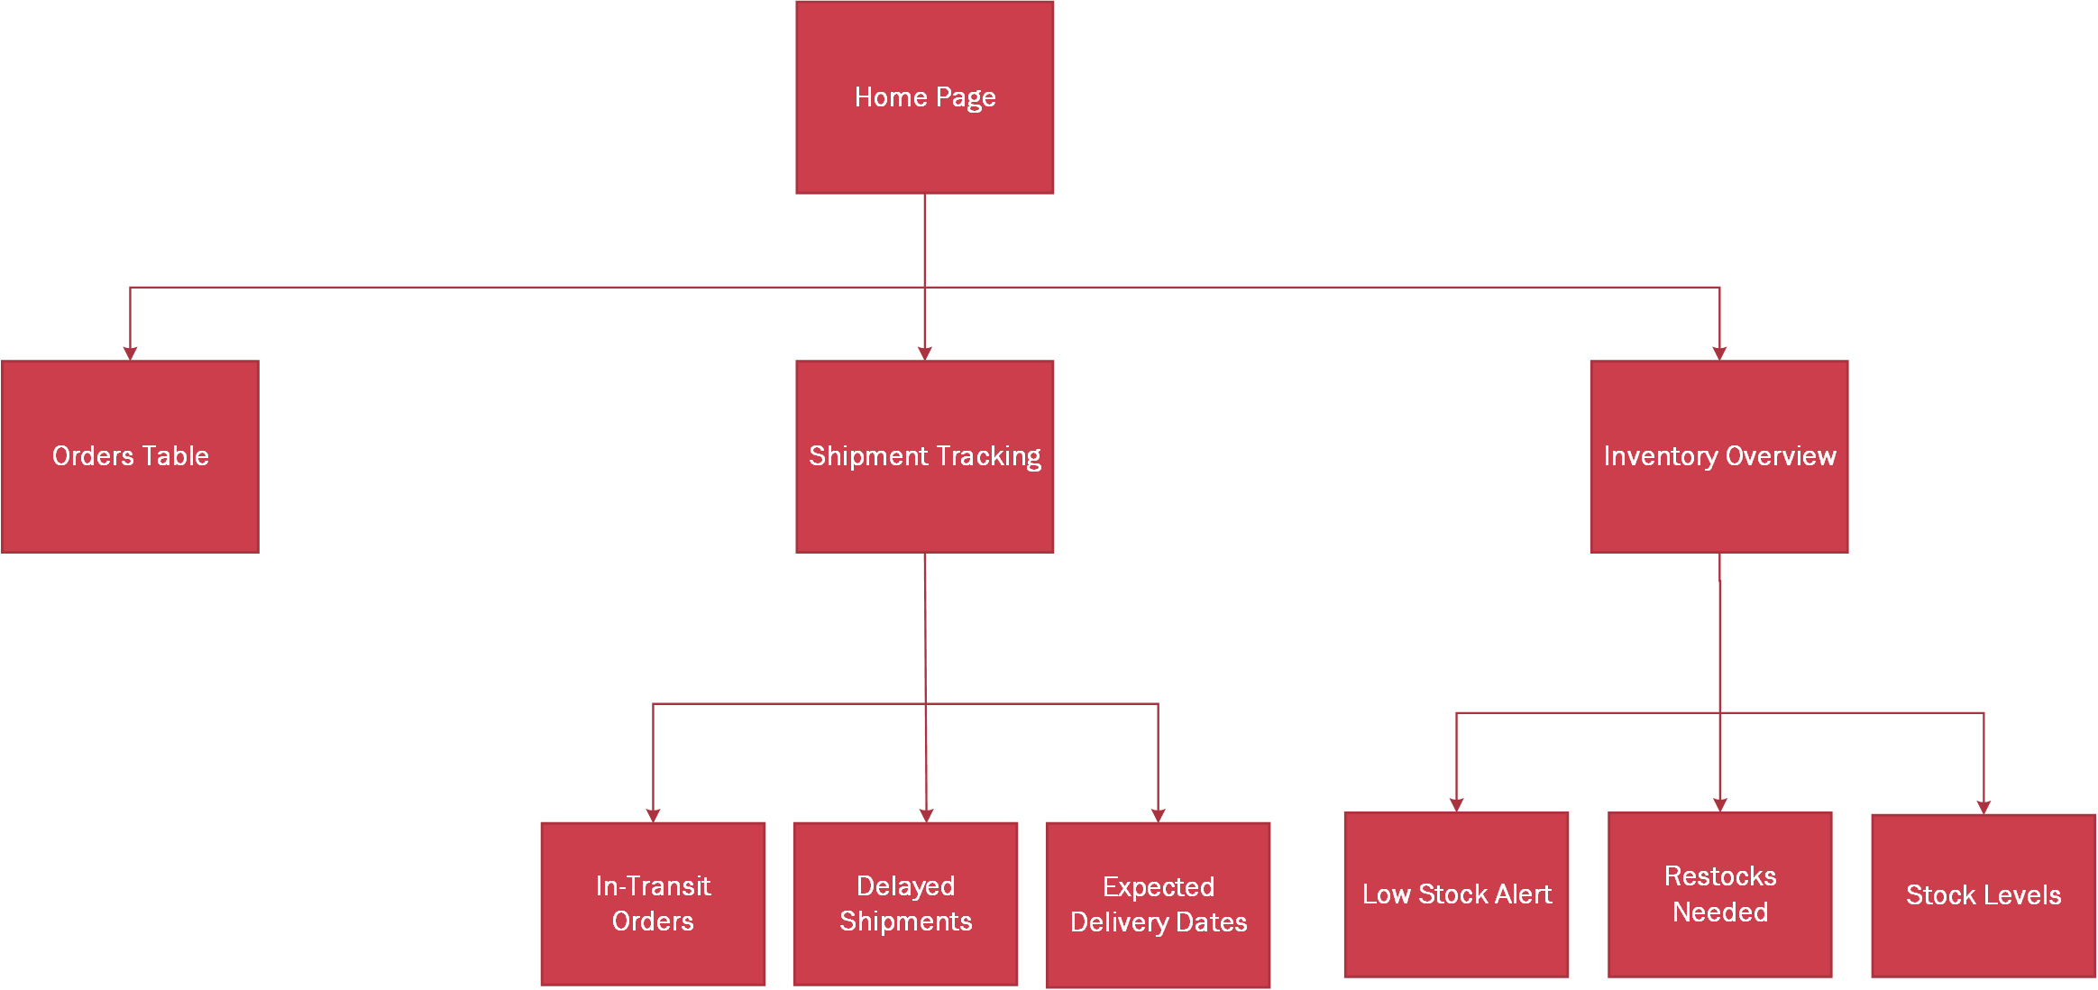
Notes:
Presenter: Hannah
Transition to next Presenter: NA this slide
This slide covers the Navigation Diagram of our IS.
The benefits of a well-defined navigation diagram are reduced development time, improved user experience and reduced training time, enhanced usability and reduced user errors, streamlined User Acceptance Testing, and Improved Stakeholder Communicaiton and Alignment.

Slide 15
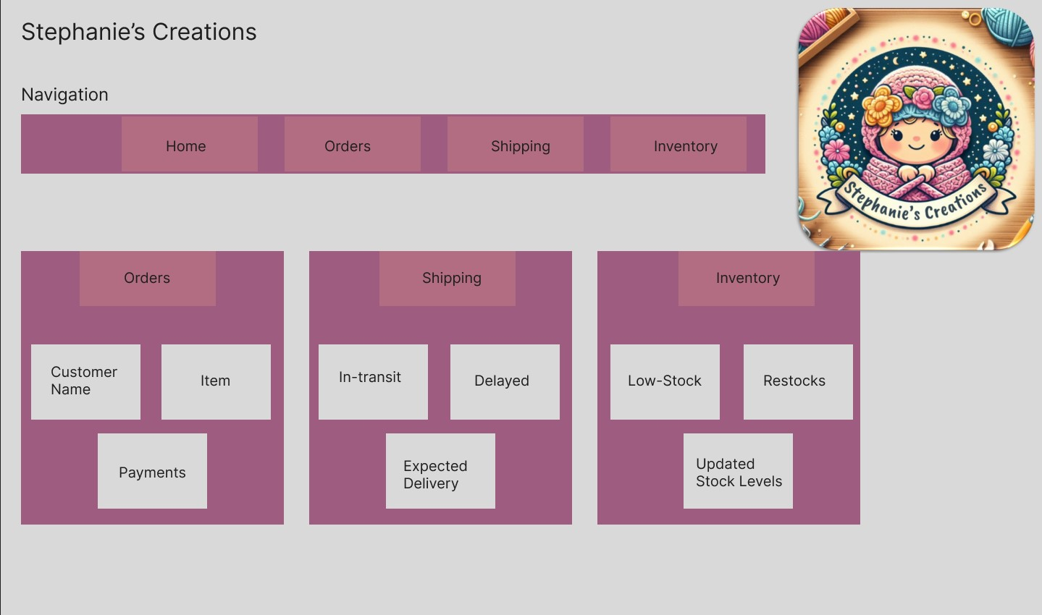
Notes:
Presenter: Hannah
Transition to next Presenter: Heather

Slide 16
Sprint highlights
Notes:
Presenter: Heather
Transition to next Presenter: NA this slide
Now, let's move on to project updates. We've successfully completed all the planned deliverables for Sprint 3 as demo'd in the previous slides.
We've updated the previous documentation to reflect the changes made in this sprint, ensuring that our documentation remains current and accurate.
By completing all planned deliverables, we've maintained our project timeline and budget, demonstrating our commitment to efficient project management.
We have also completed the Sprint 3 Backlog and Burn Down Chart, which shows that we have completed all planned work for this sprint.

Slide 17
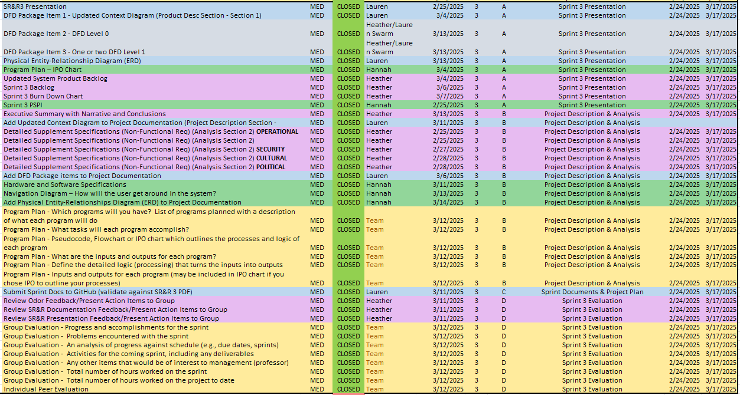
Notes:
Presenter: Heather
Transition to next Presenter: NA this slide
Here is the Sprint 3 Backlog. As you can see, we broke down the work into manageable tasks, and assigned them to team members.
Since our IS is being developed in an agile environment, our thoroughly managed Project and Sprint Backlogs have benefited our team in the following areas: enhanced transparency and communication, increased predictability and planning, and improved quality and accountability.
The bulk of deliverables for Sprint 3 was foundational for future construction of our IS, as a result we focused on prioritization, reducing future rework needs, and better resource allocation.
By prioritizing backlog items, our team was able to focus on the most important tasks, maximizing efficiency and productivity.
By clearly defining requirements and tasks, our backlog has reduced the risk of wasted effort and lead to more efficient use of our resources.
Through better resource allocation, we have a better handle on the scope of our work, the tasks involved, and will be able to ensure faster project completion.

Slide 18
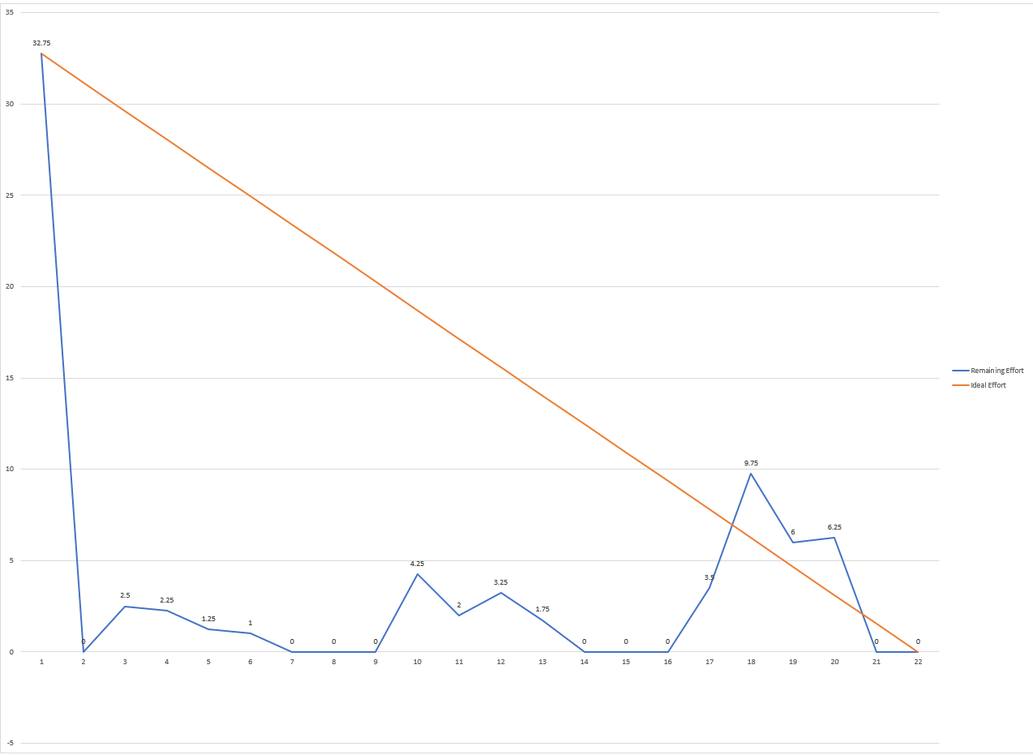
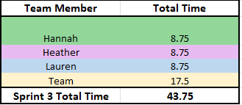
Notes:
Presenter: Heather
Transition to next Presenter: NA this slide
This is our Sprint 3 Burn Down Chart. As you can see, we have completed all work for this sprint, and are on target for future sprints.
I would like to take a moment explain the spike in activity and effort above the ideal line on our Burn Down Chart. After completing our assigned backlog items individually, our team decided to collaborate on the best ways to incorporate engaging visuals and feedback received previously into our Sprint 3 work.
We are confident in our efforts to deliver a stronger presentation to you tonight. We also hope you enjoyed the story we told tonight as we focused on the benefits of our deliverables for this Sprint.

Slide 19

Any Questions?
Notes:
Presenter: Heather
Transition to next Presenter: NA this slide
This concludes our presentation, but we would like to encourage your feedback on the deliverables we demo’d. Your input is crucial for ensuring that we are on the right track. Please feel free to ask any questions you have now.

